Slide 1
Introduction to java

Slide 2

Objective:
History of Java
Features of Java
Java Virtual Machine (JVM) and bytecode
Explain Java Runtime Environment (JRE) and Java Development Kit (JDK)

Slide 3
Introduction:
Java is an object oriented programming language.
It has syntax similar to C and C++.
It is platform independent.
Java Platform provides a complete environment for application development on desktops and servers and for deployment in
embedded environments.
.

Slide 4
History of Java
• The original name of Java was Oak, and it was developed as a part of the Green project at Sun Microsystems.
• Java was conceived by James Gosling, Patrick Naughton, Chris Warth, EdFrank, and Mike Sheridon at Sun Microsystems in 1991.
• Java was devised to have a programming language that is platform and architecture independent and also supports creation of distributed applications.

Slide 5
Features of Java
The following are the features of Java:
• Simple
• Object oriented
• Secure
• Platform independent
• Robust
• Dynamic
• Multithreaded
• Distributed

Slide 6
Java Application
Java can be used for writing Standalone applications, Client Programs like applets and Server Programs like Servlets and JSP.
Can be used to write reusable software business components called as EnterpriseJavaBeans.

Slide 7
JDK- Java Development Kit
Compiler
Debugger
Doc development tool
Policy tool
JRE
Jar
Etc…

Slide 8
J V M
Java Virtual Machine (JVM) specification defines the JVM as an imaginary (virtual) machine that is implemented by emulating it in software on a real
machine. Code for the JVM is stored in .class files, each of which contains code for at most one public class.
• This specification enables the Java software to be platform independent.
• JVM is implemented in a Java technology development tool or in a Web browser

Slide 9
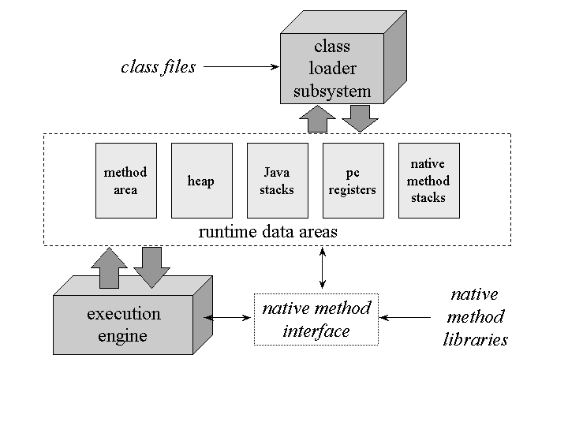
JVM components
Notes:
Types (Hierarchy) of Java Class Loaders
Java class loaders can be broadly classified into below categories:
Bootstrap Class Loader Bootstrap class loader loads java’s core classes like java.lang, java.util etc. These are classes that are part of java runtime environment. Bootstrap class loader is native implementation and so they may differ across different JVMs.
Extensions Class Loader JAVA_HOME/jre/lib/ext contains jar packages that are extensions of standard core java classes. Extensions class loader loads classes from this ext folder. Using the system environment propery java.ext.dirs you can add ‘ext’ folders and jar files to be loaded using extensions class loader.
System Class Loader Java classes that are available in the java classpath are loaded using System class loader.

Slide 10
Compilation and execution of java program
Compilation:
javac <source file>
Eg: javac Sample.java
Execution:
java <class name> <cmd line args >
java Sample 23 34

Slide 11
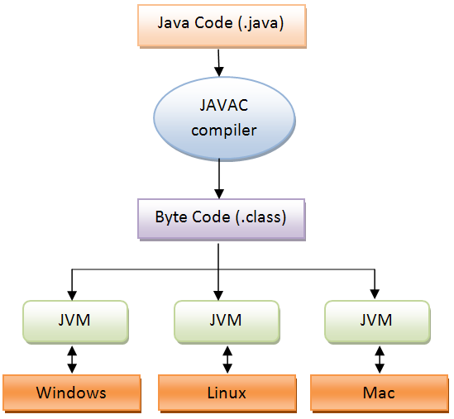

Slide 12
Overview of JVM
Bytecodes:
• Bytecode is a highly optimized set of instructions designed to be executed by the JVM.
• The key that allows Java to solve both the security and the portability problems is the output of a Java compiler, which is not an executable code rather it is the bytecode.
• The JVM is ported to different platforms to provide hardware and operating system independence, which is an environment independent of hardware and operating system
• JVM needs to be implemented for each platform.

Slide 13
J2SE Runtime Environment (JRE)
J2SE stands for Java2 Standard Edition.
• The JRE provides the libraries, JVM, Java Interpreter, and other components necessary to run applets and applications written in Java.
• JRE is responsible for loading, verifying, and executing the bytecodes.
• The JDK includes the JRE as well as command-line development tools, such as compilers and debuggers that are necessary or useful for developing applets and applications.
• The Java API is pre-written code, organized into packages of similar topics, and it is a part of JDK libraries.

Slide 14
Demo
/* Every Java program contains at least one class
specification. A class is where all actions take place
within a Java program. All Java applications begin
execution at main method.
*/
public class HelloWorld{
public static void main(String args[]){
System.out.println("Hello, World!");
}
}

Slide 15
Command line arguments
Java Sample 45 67 78
45 67 78 are stored in form of array of Strings.
String is a builtin class.
args[0] -- 45
args[1] -- 67
args[2] -- 78
args.length ----size of array which is 3
To get the numerical value..
Eg: int n=Integer.parseInt(args[0]).

Slide 16
Note:
main is static so that it gets called directly with the class name without any object.
It can access only static members of the class directly.

Slide 17
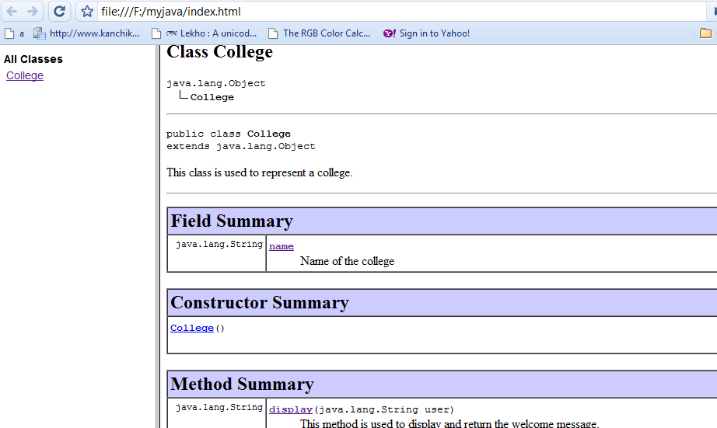
javadoc
Tool that is used to produce HTML pages by parsing through the documentation comment in java source code.
Produces documentation for public and protected classes/members.
Works on entire package or a single source file
Usage on source file
javadoc sourcefilename.java
javadoc College.java

Slide 18
JAR
A JAR (Java Archive) is a package file format typically used to aggregate many Java class files and associated metadata and resources (text, images, etc.) into one file to distribute application software or libraries on the Java platform. In simple words, a JAR file is a file that contains compressed version of .class files, audio files, image files or directories.

